Slide 1
Project Worker
Information for candidates

Slide 2
Hello from Us
First of all, we are delighted that you are interested in joining our team at Children 1st.
We are really keen to have someone join us that shares Children 1st’s values and who will help develop and progress our connection with children and their families in Midlothian.
A key aspect of our family support is taking the time to build strong relationships with families, based on trust and gaining an understanding of what they need rather than what we can offer. In Midlothian we are funded to support families impacted by parental substance use, kinship care and promoting positive mental health for both children young people and their parents. We also offer financial wellbeing advice too, attending to the pressures families experience exacerbated by the impact of poverty.
We have strong links with partner agencies and have a community presence in different locations in Midlothian, from which we offer individual and group based supports.
If you are interested in hearing more about the role please feel free to get in touch:
Midlothian Family Wellbeing Hub:
Midlothian@children1st.org.uk
Or call 0131 6549540 and ask to speak with either Johnny or Lauren

Slide 3
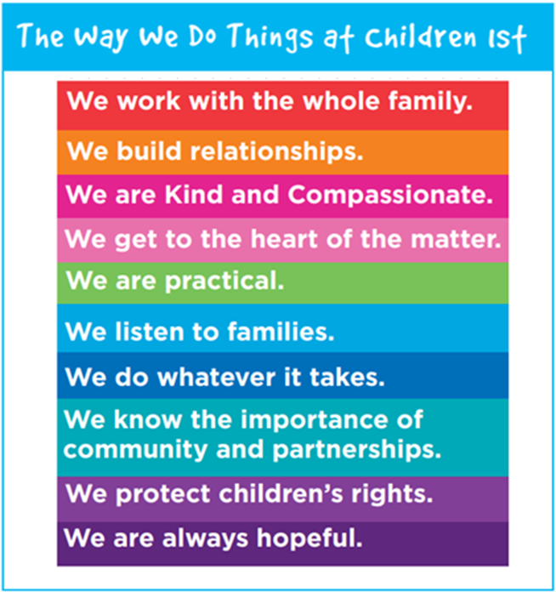
About Children 1st

Slide 4
The Team
Midlothian Family Wellbeing Hub
You will be joining our small but enthusiastic team which is made up of a 5 other project workers, peer support workers, a financial wellbeing advisor, administrator, peer volunteers, sessional workers, team leader and the service manager. We also provide placements for social work students.
We work alongside families primarily impacted by parental substance use, taking a systemic whole family approach to understanding the challenges that they experience. Our practice is trauma informed, relational and founded on compassion and respect for the families we support. We are creative, committed and flexible in our approach.

Slide 5
What opportunities are available?
What roles are available?
We have 4 positions available, connected to both existing and new funding enabling us to increase our capacity to support kinship families impacted by parental substance use as well as families experiencing poor mental health.
Project workers will support families across all funding areas, offering flexible, dynamic support. This will include:
Individual support to children, young people and their parents
Whole family, systemic approach
Group work for young people
Activity based support for families

Slide 6
What does being a project worker with Children 1st look like?
(You will find much more information about the requirements needed for the role within the job description and person specification so be sure to give that a read over before applying!)
You will:
Build relationships with families based on trust – ensuring that we get to know them individually and as a whole family
Work alongside families to develop plans based on their hopes
Work in partnership with families and partner agencies to achieve meaningful progress
Support family activity and group sessions
Joint approach with peer workers to support parents into recovery orientated supports
Work creatively with children and parents to understand the impact of trauma and support children to have a voice
Work systemically with families to support stronger family relationships
Work within a children rights based approach
Work flexibly, within our community based settings to support earlier connection with the service
Work with our financial wellbeing advisor to alleviate the impact of poverty

Slide 7
Salary, Annual Leave and Benefits
The salary scale for the role is £29,500 to £34,490. Your holiday entitlement is 40 days (inclusive of 9 public holidays). We also have a contributory pension scheme (the charity will pay up to 8% of your salary) and life assurance.
Wellbeing and Balance
At Children 1st we recognise the importance of looking after your health and wellbeing. We have a flexible working policy in place to support your work/life balance and our Human Resources team will be happy to discuss other available supports in more detail.
Geography and Location
We are based in Dalkeith but work across Midlothian including the use of a base in Penicuik co-located in the Penicuik Wellbeing Hub. There will be some capacity to work from home within our flexible working policy
Diversity and Inclusion
We seek to tackle all forms of discrimination both internally and externally. We recognise that we are not as fully representative as we want to be yet and we are challenging ourselves every day. We welcome and encourage applications from diverse backgrounds and will always consider transferable skills and experience.
Some questions you might have

Slide 8
